Slide 1
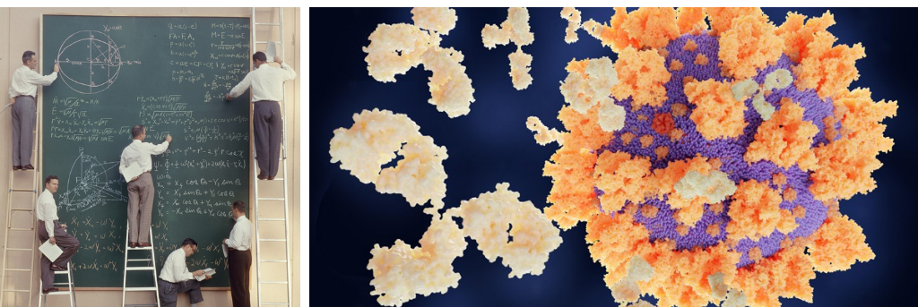
Toward a
Computational Precision Medicine
Mickaël Guedj

Slide 2



Background
1999 - 2004 INSA Lyon
2004 - 2007 PhD at Genopole / Merck-Serono
2007 - 2009 Computational Biologist
Ligue Nationale contre le Cancer
2009 - 2018 Chief Data Officer
Pharnext
2018 - 2021 Head of Computational Medicine
Servier
since 2021 Head of Biometrics, Data & Decision Sciences
Nanobiotix
2005 - 2011 ENSAI Rennes
mickael.guedj@gmail.com
https://www.linkedin.com/in/mickaelguedj

Slide 3
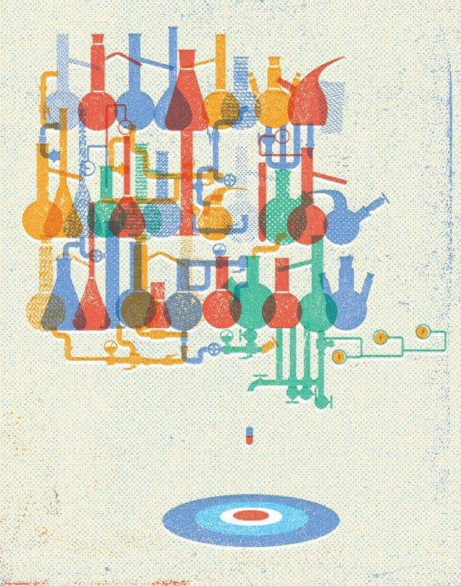
Principles
Computational Precision Medicine
Integrate understanding of disease mechanisms & patient heterogeneity
By opposition to one-size-fits-all
Highly data & model-driven
Related
Stratified, Integrated, Systems, Network, In Silico, Digital, Data-driven, Translational
4P: Predictive, Preventive, Personalized & Participative
Credit: Lorenzo Gritti

Slide 4
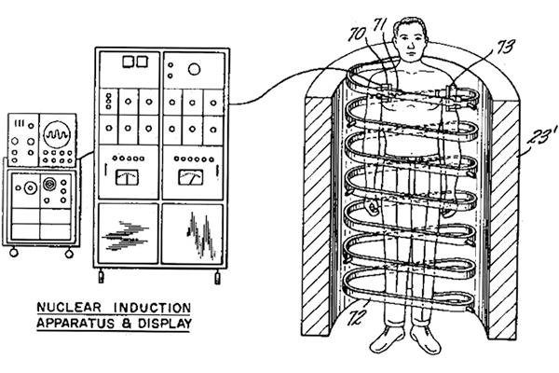
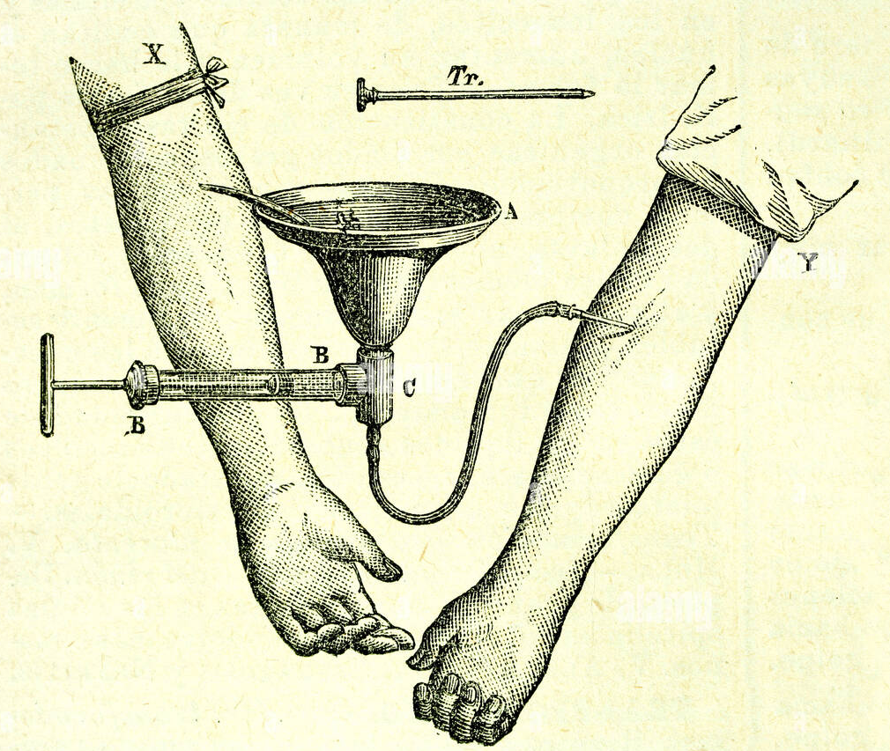
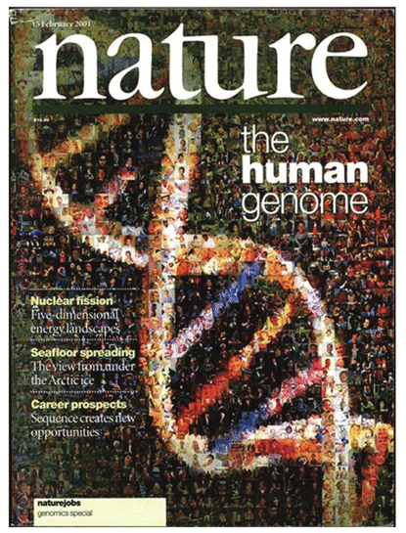
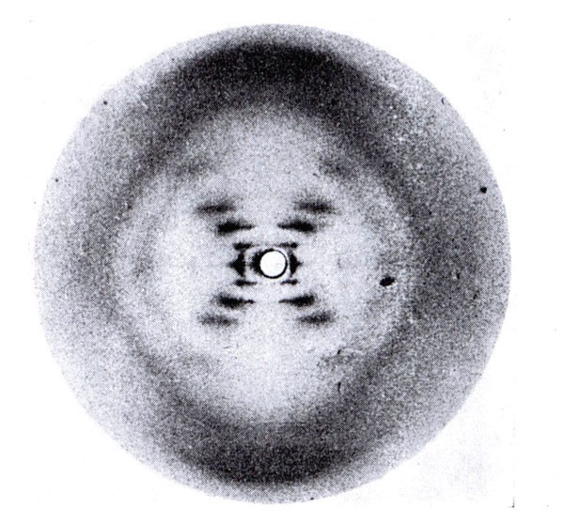
Brief history
aspirin
Can machines
think ?
Chi-square, t tests
& p-values
1st AI
program
MRI
Deep Blue defeats
Gary Kasparov
PCA
1900
1950
Declaration
of Helsinki
2000
FDA
QSAR
BLAST
Blood groups
penicilin
DNA
Electronic
Health Record
insulin
1st sequencing
of human genome
Mendel laws
Mass spectroscopy
herceptin

Slide 5
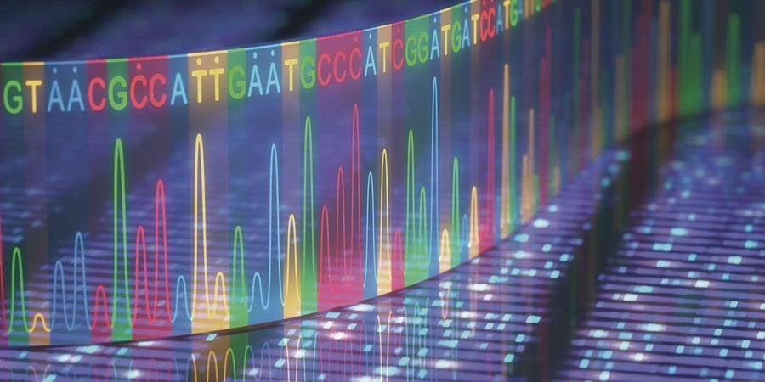
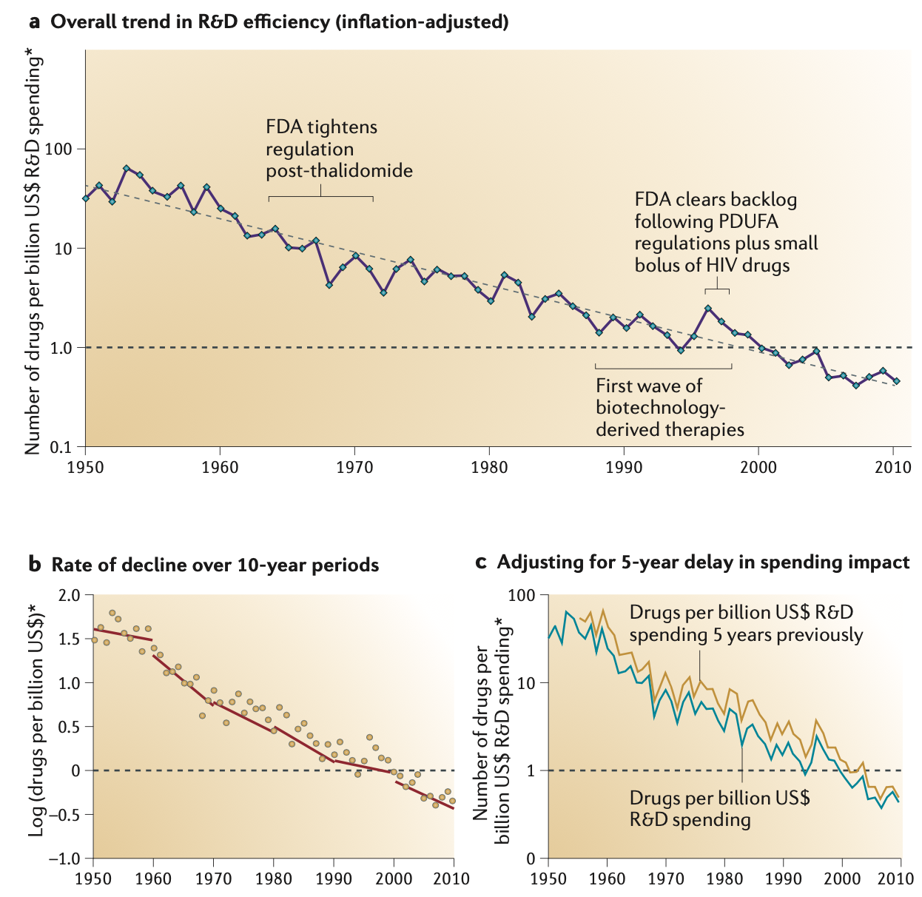

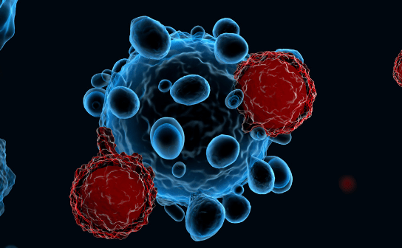
Since 2000
Large-scale & multimodal
patient profiling
Decline of
R&D productivity
Diversification of
therapeutic strategies
Data storage, access
& treatment capacities

Slide 6
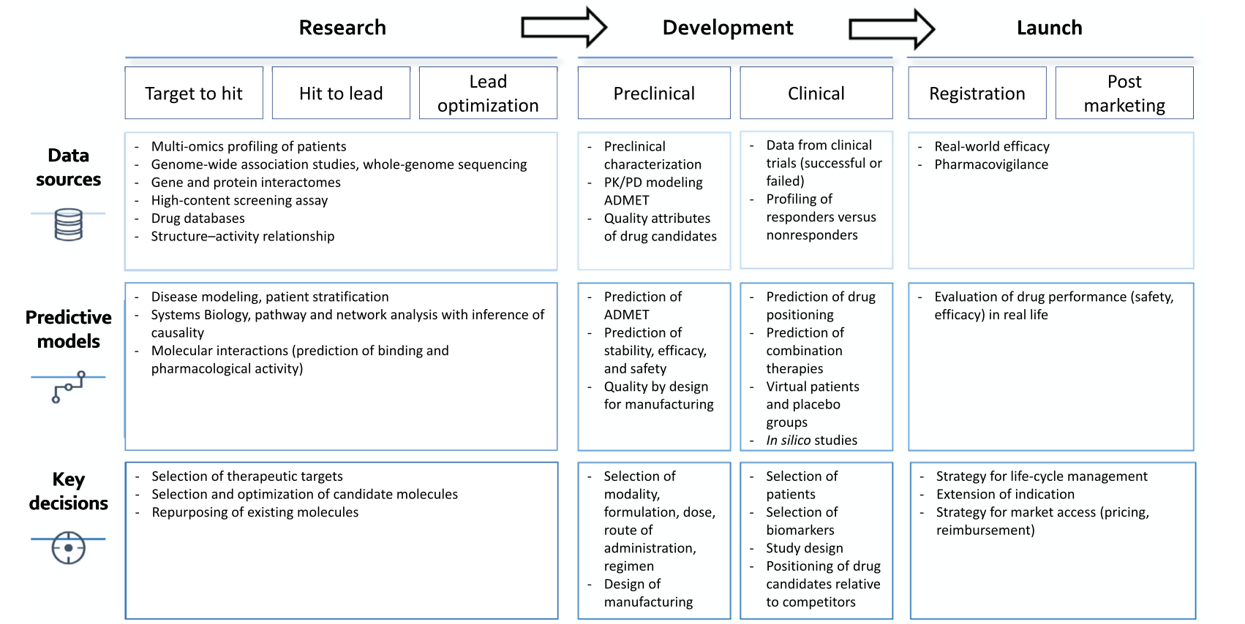

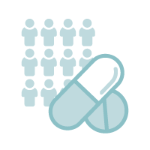

Data-driven decision making in drug discovery & development
[Moingeon et al 2022]

Slide 7





































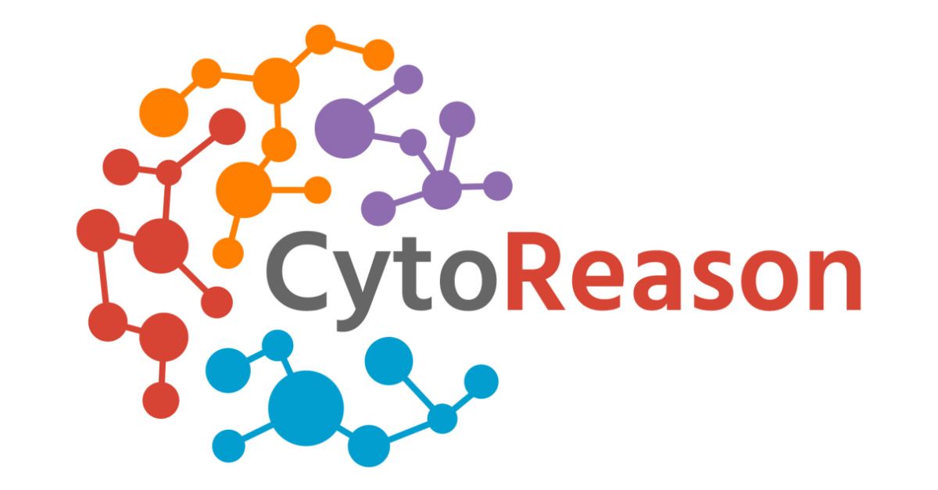



Industrial ecosystem
Pharma
Tech
Platforms
AI-based biotech
AI service & tools
Academics

Slide 8
Data

Slide 9
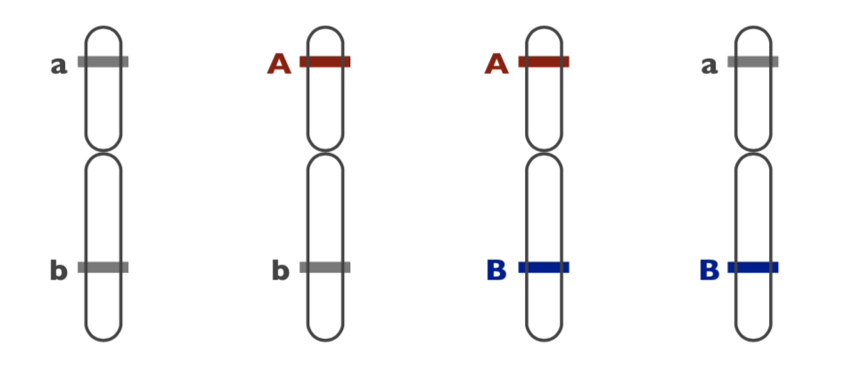
Genetics as a key entry
constitutional
versus
tumoral
initial population
recombination
46 chromosomes
(23 pairs + XX or XY)
DNA
- common & abundant
- 1/100 to 1/1000 bp
- capture 90% of total variation
2% of
protein-coding genes
~6.4 base pairs
mutation
LD blocks
Key concepts
Locus - Allele - Polymorphism - Genotype - Haplotype - Homozygote - Heterozygote - Mutation - Recombination - Linkage Disequilibrium - Minor Allele Frequency - Single Nucleotide Polymorphism - Functional - Neutral
~25k protein
coding genes
98% of
non-coding sequence

Slide 10
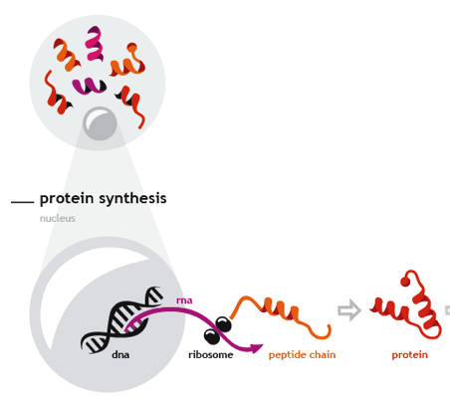
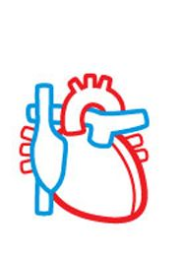
Health as equilibrium of connected systems
CELL
metabolites
life style
& environnent
regulations
⇨
⇨
⇨
⇨
⇨
cellular
processes
⇨
HEALTH
gene expression
bio-molecular
networks / pathways / interactome

Slide 11
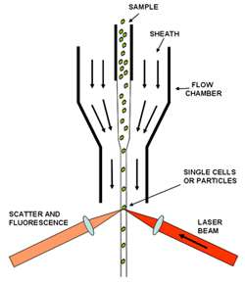
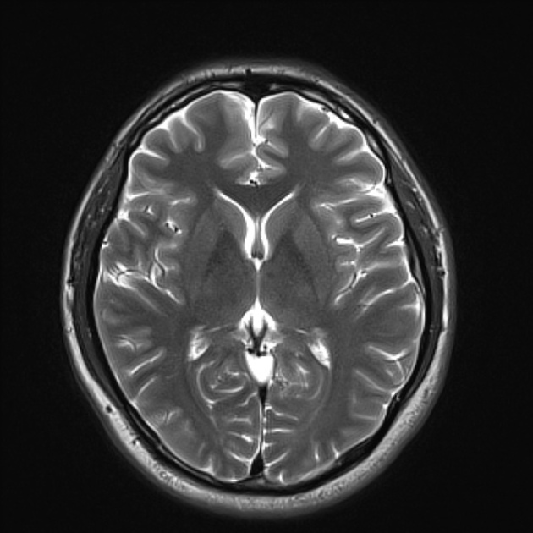
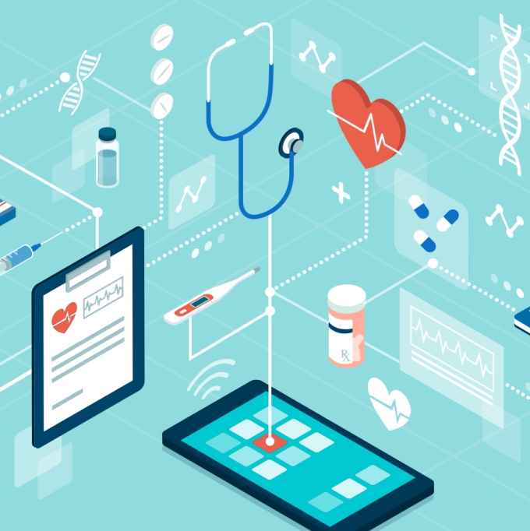
Capturing the value of big biomedical data
  High-throughput technology platforms
microarray
sequencing
spectroscopy
cytometry
imaging
electronic
capture

Slide 12

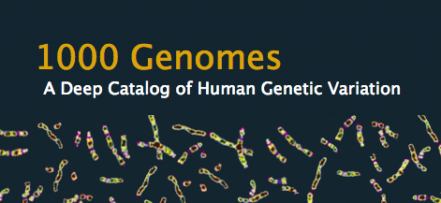









Capturing the value of big biomedical data
  High-throughput technology platforms
Big data collecting initiatives
public, private, national, international, population-based, disease-centric
microarray
sequencing
spectroscopy
cytometry
imaging
electronic
capture

Slide 13











Capturing the value of big biomedical data
  High-throughput technology platforms
Big data collecting initiatives
public, private, national, international, population-based, disease-centric
microarray
sequencing
spectroscopy
cytometry
imaging
electronic
capture
  Structured data / knowledge bases

Slide 14
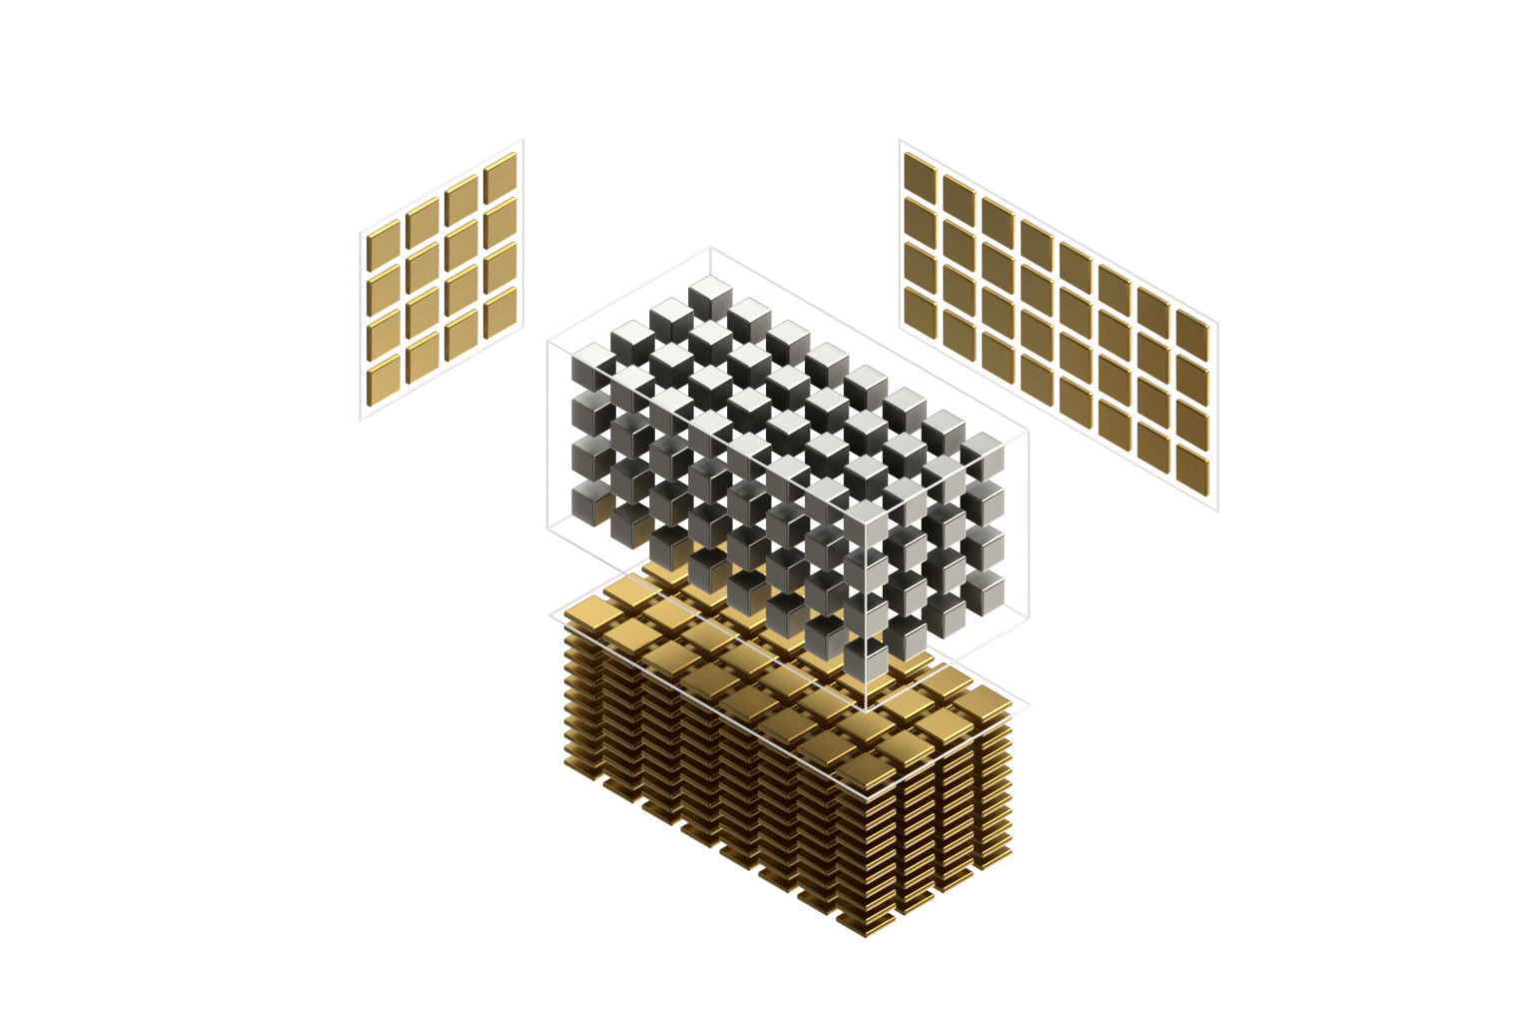

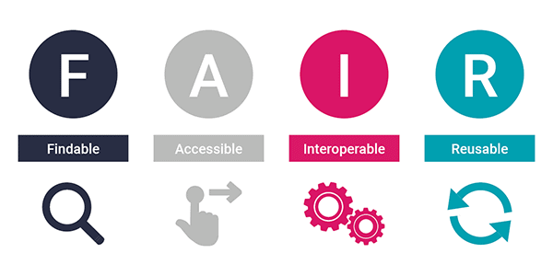

Data-associated challenges
Emerging standards
& guidance
complexity
heterogeneity
dimensionality
unicity
completion
reliability
reproducibility
infrastructure
governance

Slide 15
Computational tool box

Slide 16
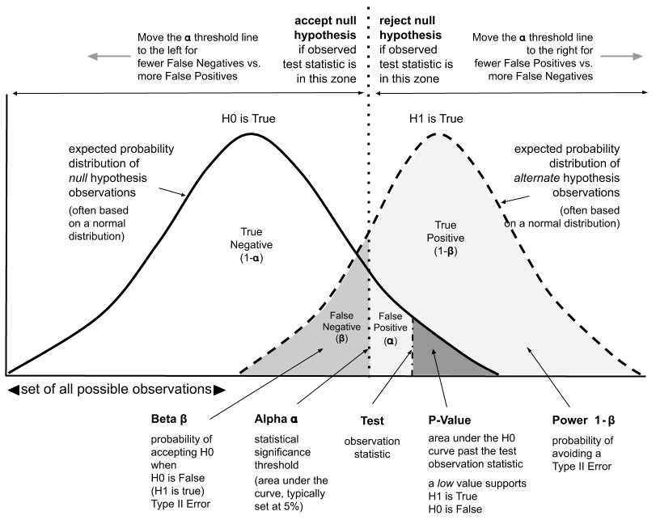
Statistical testing & modelling

Slide 17
Statistical testing & modelling
Multiple-testing
- FWER, FDR, q-value, local FDR
- Bonferroni, Benjamini-Hochberg

Slide 18
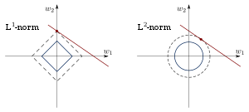
Statistical testing & modelling
Multiple-testing
- FWER, FDR, q-value, local FDR
- Bonferroni, Benjamini-Hochberg
Model estimation & variable selection
- Ridge, LASSO, Elastic Net

Slide 19
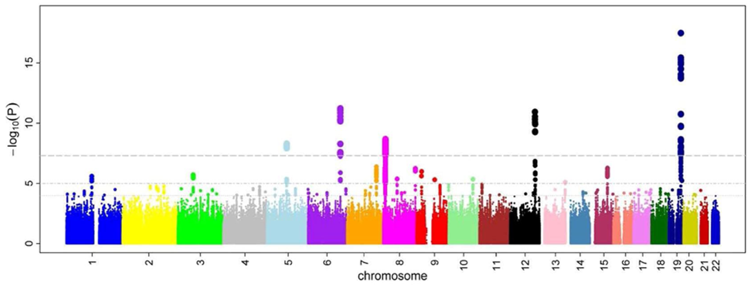
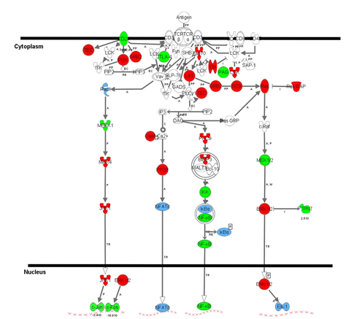
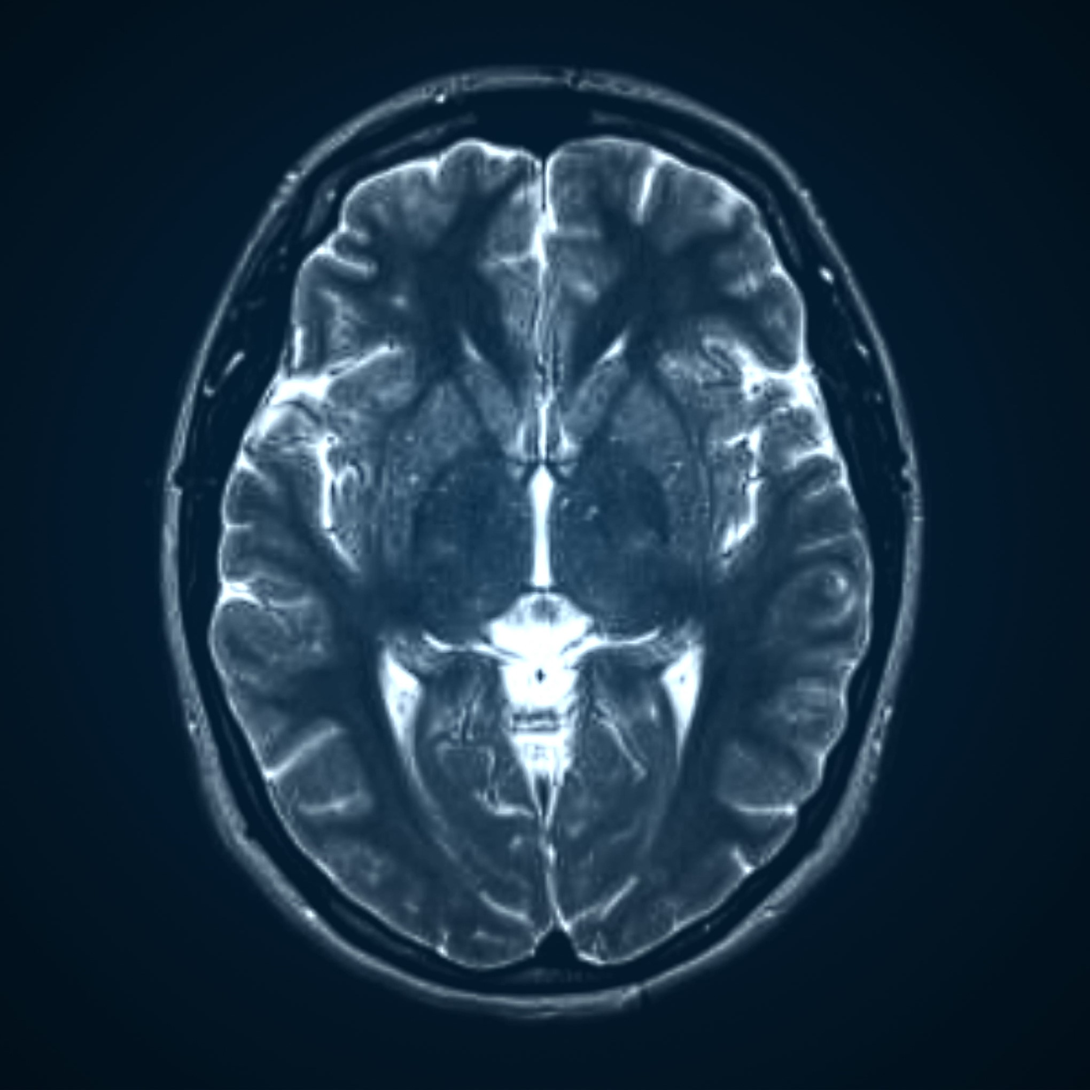
Statistical testing & modelling
Multiple-testing
- FWER, FDR, q-value, local FDR
- Bonferroni, Benjamini-Hochberg
Model estimation & variable selection
- Ridge, LASSO, Elastic Net
Spatiality
- sliding-window, local score, enrichment

Slide 20
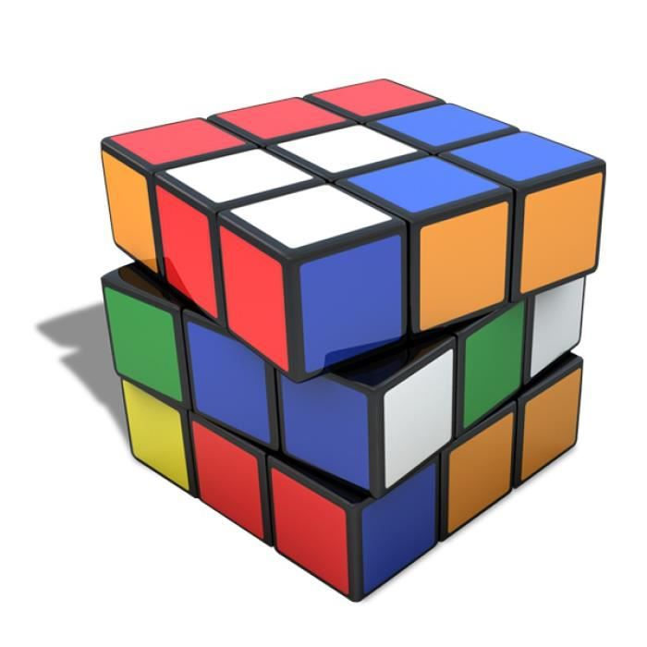

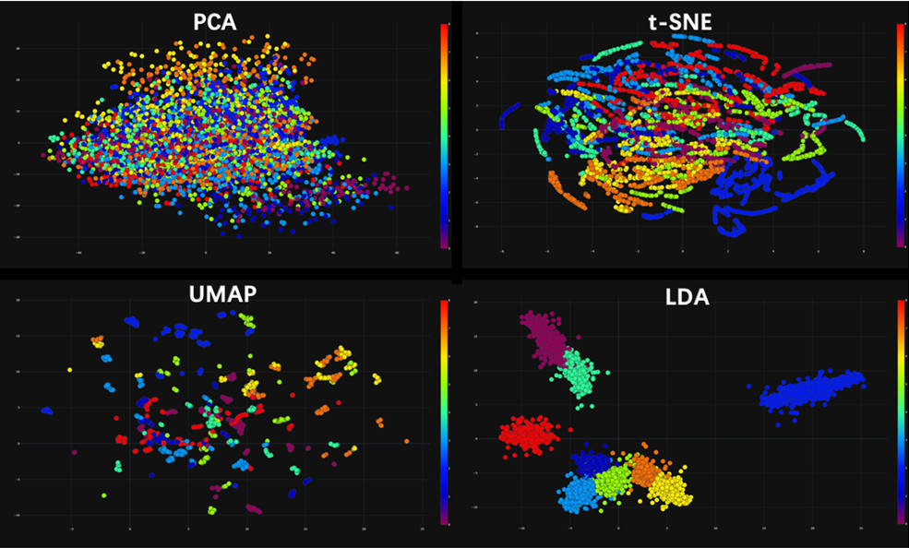
Dimension reduction
Transformation of data from a high-dimensional space into a low-dimensional space so that it retains some meaningful properties
- Principal Component Analysis (PCA)
- Uniform Manifold Approximation and Projection (UMAP)
- t-distributed stochastic neighbour embedding (t-SNE)
- Auto-encoders
f()

Slide 21
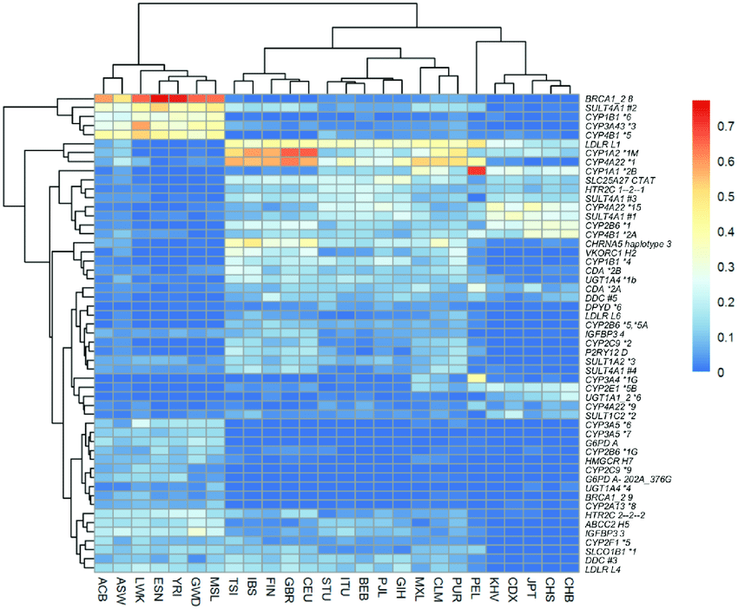
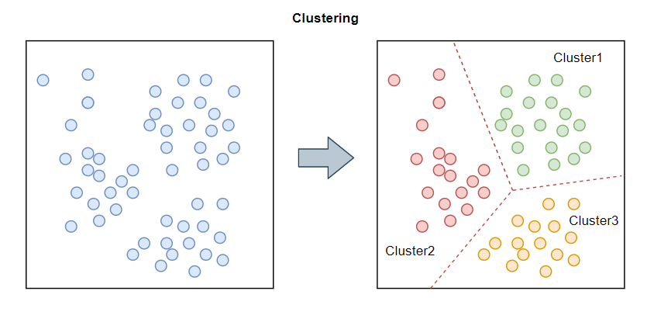
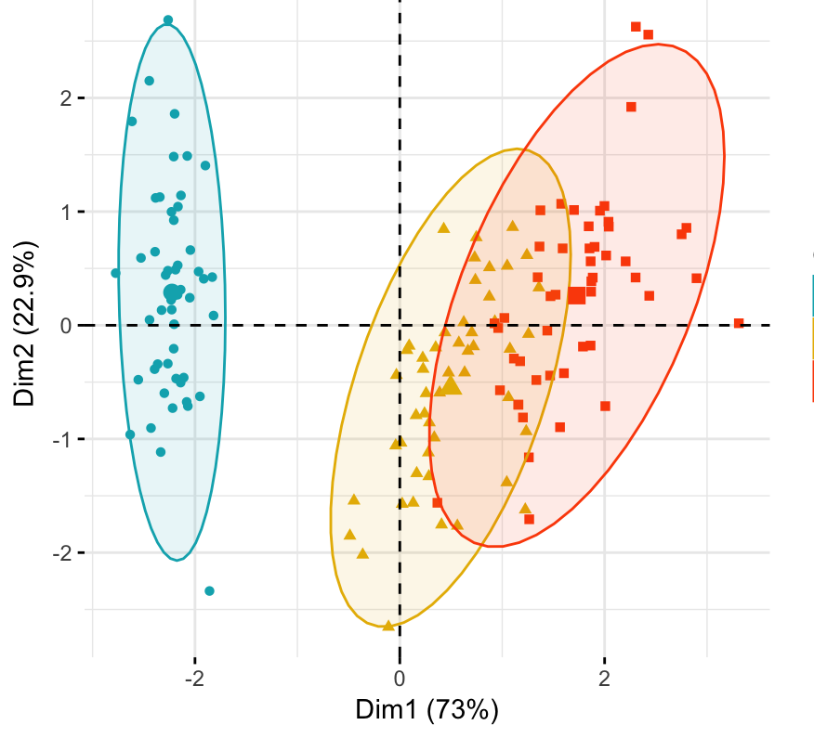
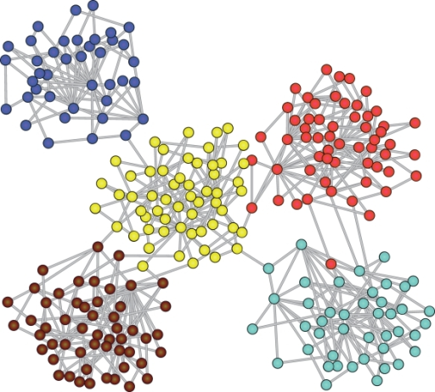
Unsupervised classification / clustering
- Connectivity approach
Hierarchical clustering
- Centroid approach
K-means
- Distribution approach
Gaussian mixture models
- Graph-based approach
WGCNA
- Decomposition approach
Spectral clustering
- Neural networks
Self-organizing map

Slide 22
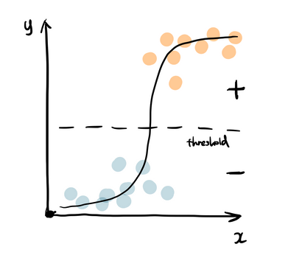
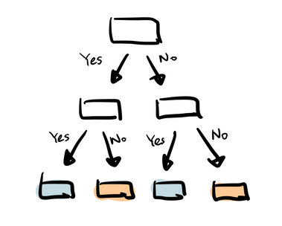
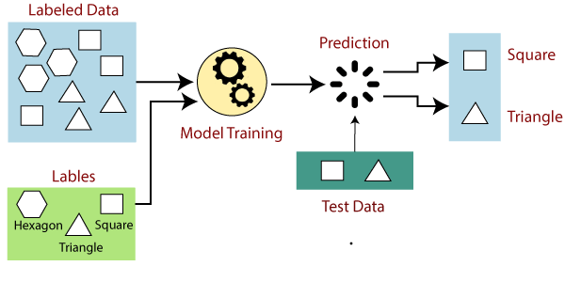
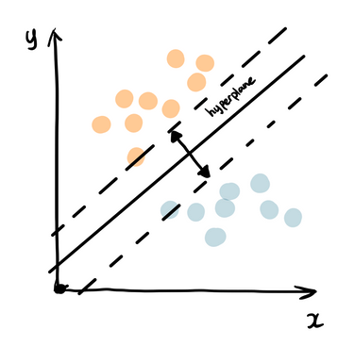
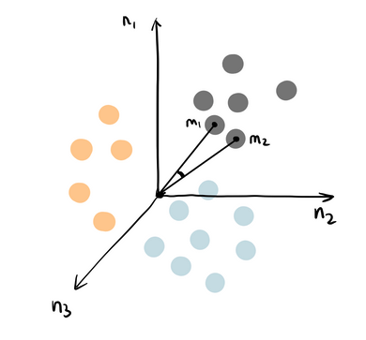
Supervised classification
- Logistic regression
- Decision tree, random forests
- Naïve bayes classifier
- Support vector machine
- K-nearest neighbour
- Neural networks
Variable Selection

Slide 23
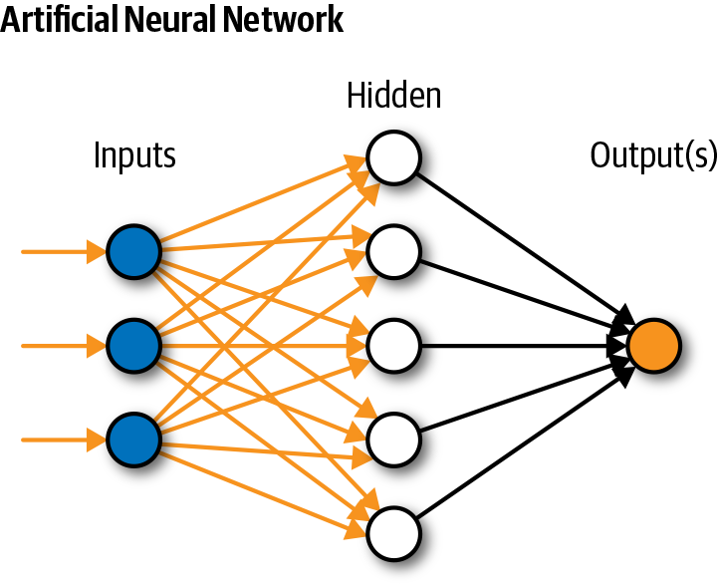
Bio-inspired algorithms
Neural networks

Slide 24
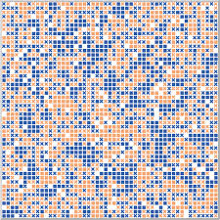
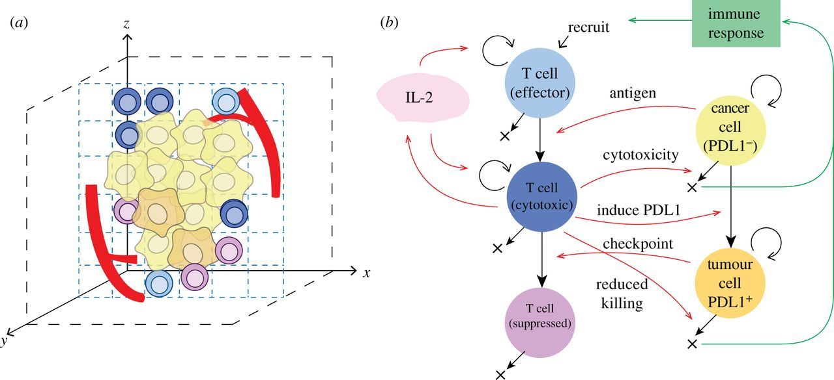
Bio-inspired algorithms
Neural networks
Multi-agent systems

Slide 25
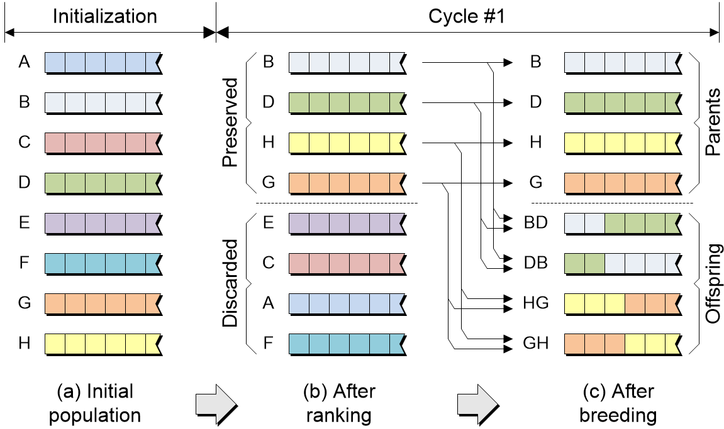
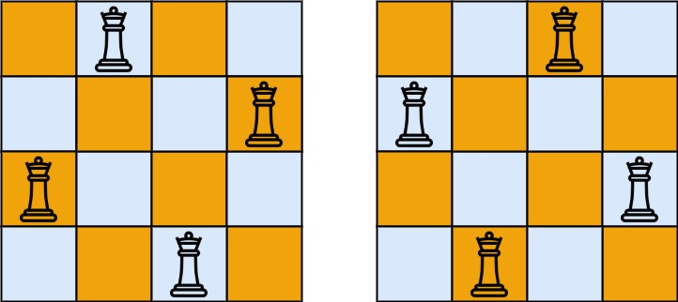
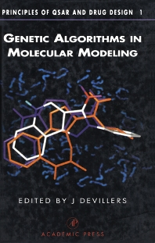
Bio-inspired algorithms
Neural networks
Multi-agent systems
Genetic algorithms
2
4
1
3

Slide 26
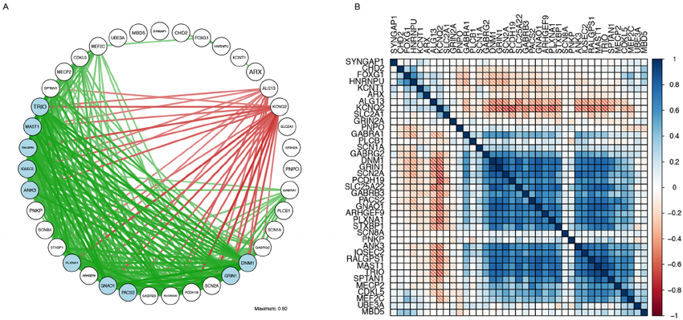
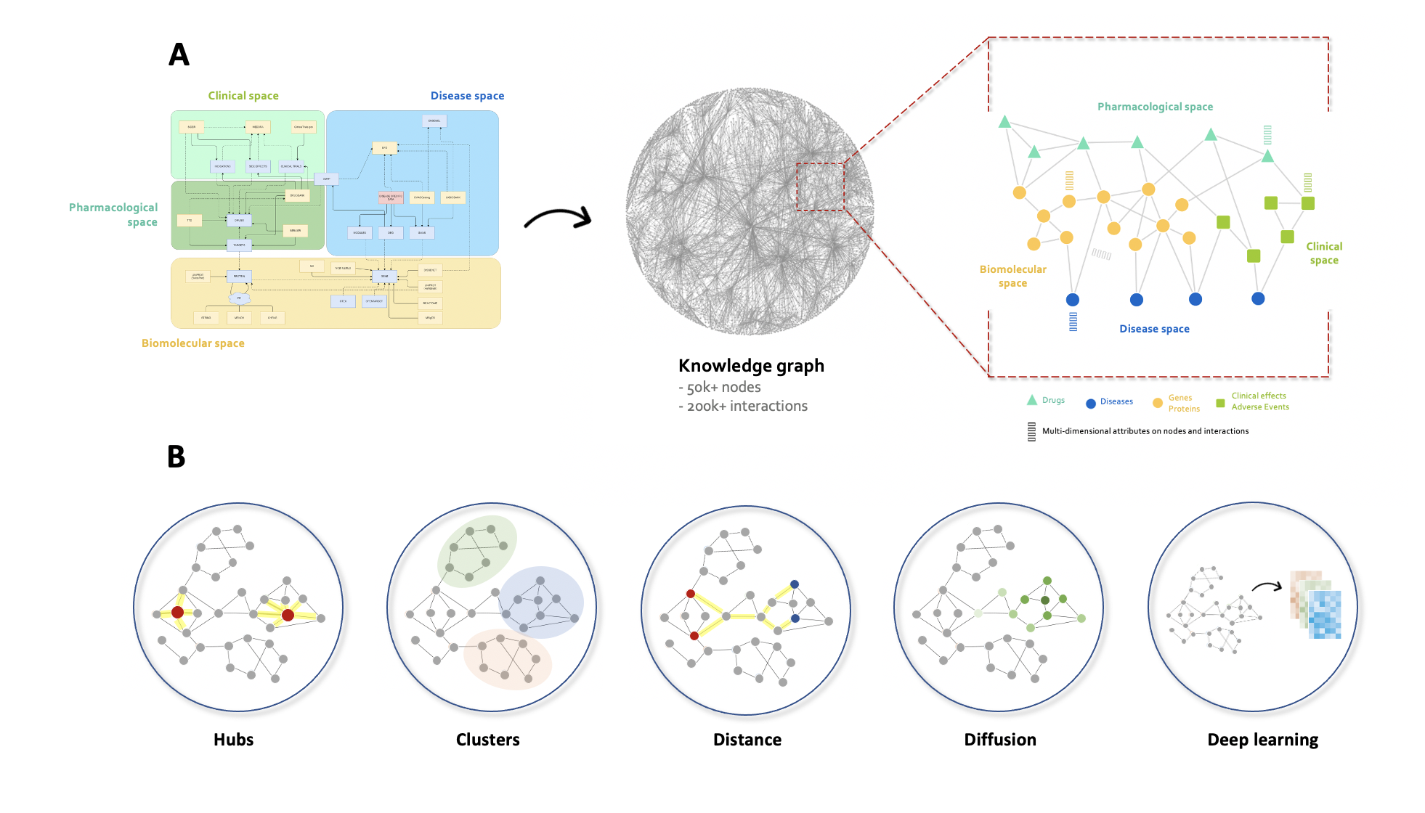
Network reconstruction
Data
Distance / adjacency
matrix
Network
Network inference
Knowledge graph

Slide 27
Network analysis

Slide 28
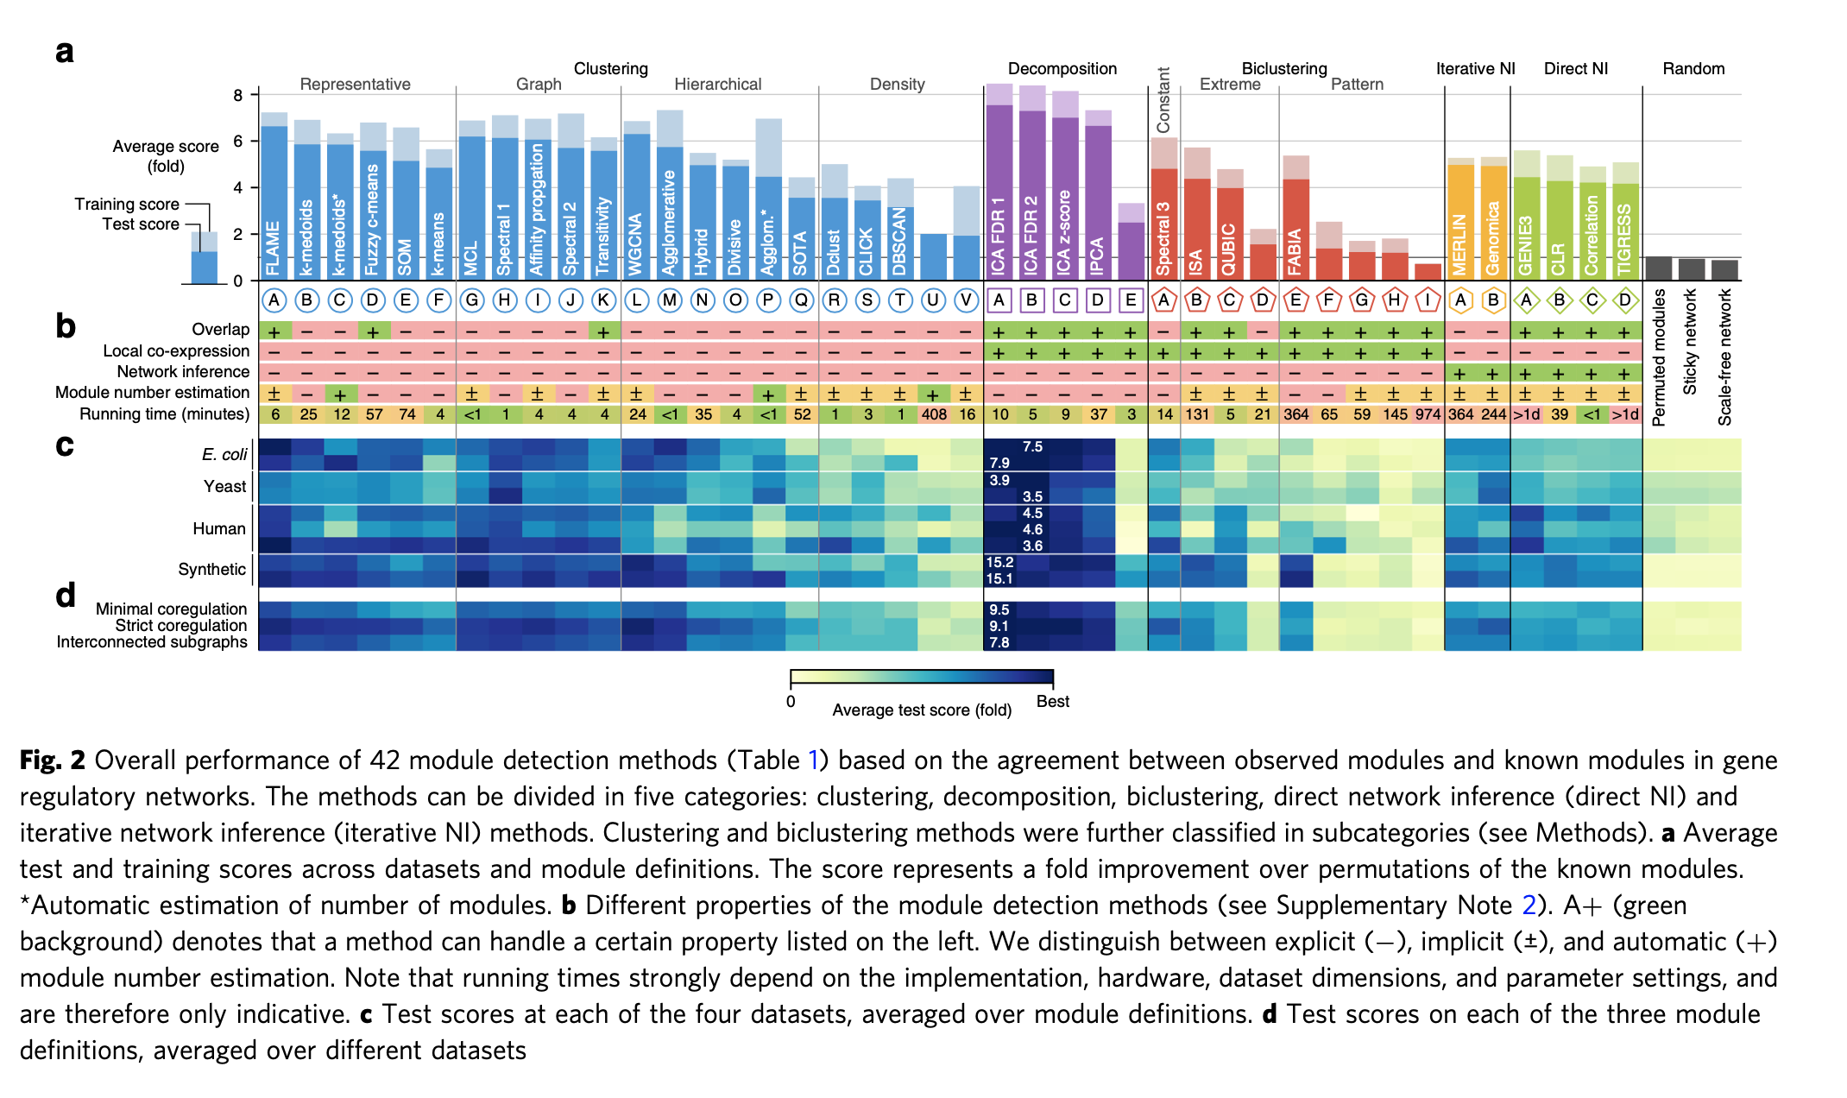



Need for benchmarks
Comparison studies
Data challenges
genedisco challenge
[Saelens et al 2018]

Slide 29
Integration of multi-sources
multi-approaches
multi-dimensions
approach 1
approach 2
approach 3
cohort 1
multi-cohorts
cohort 2
cohort 3
29

Slide 30
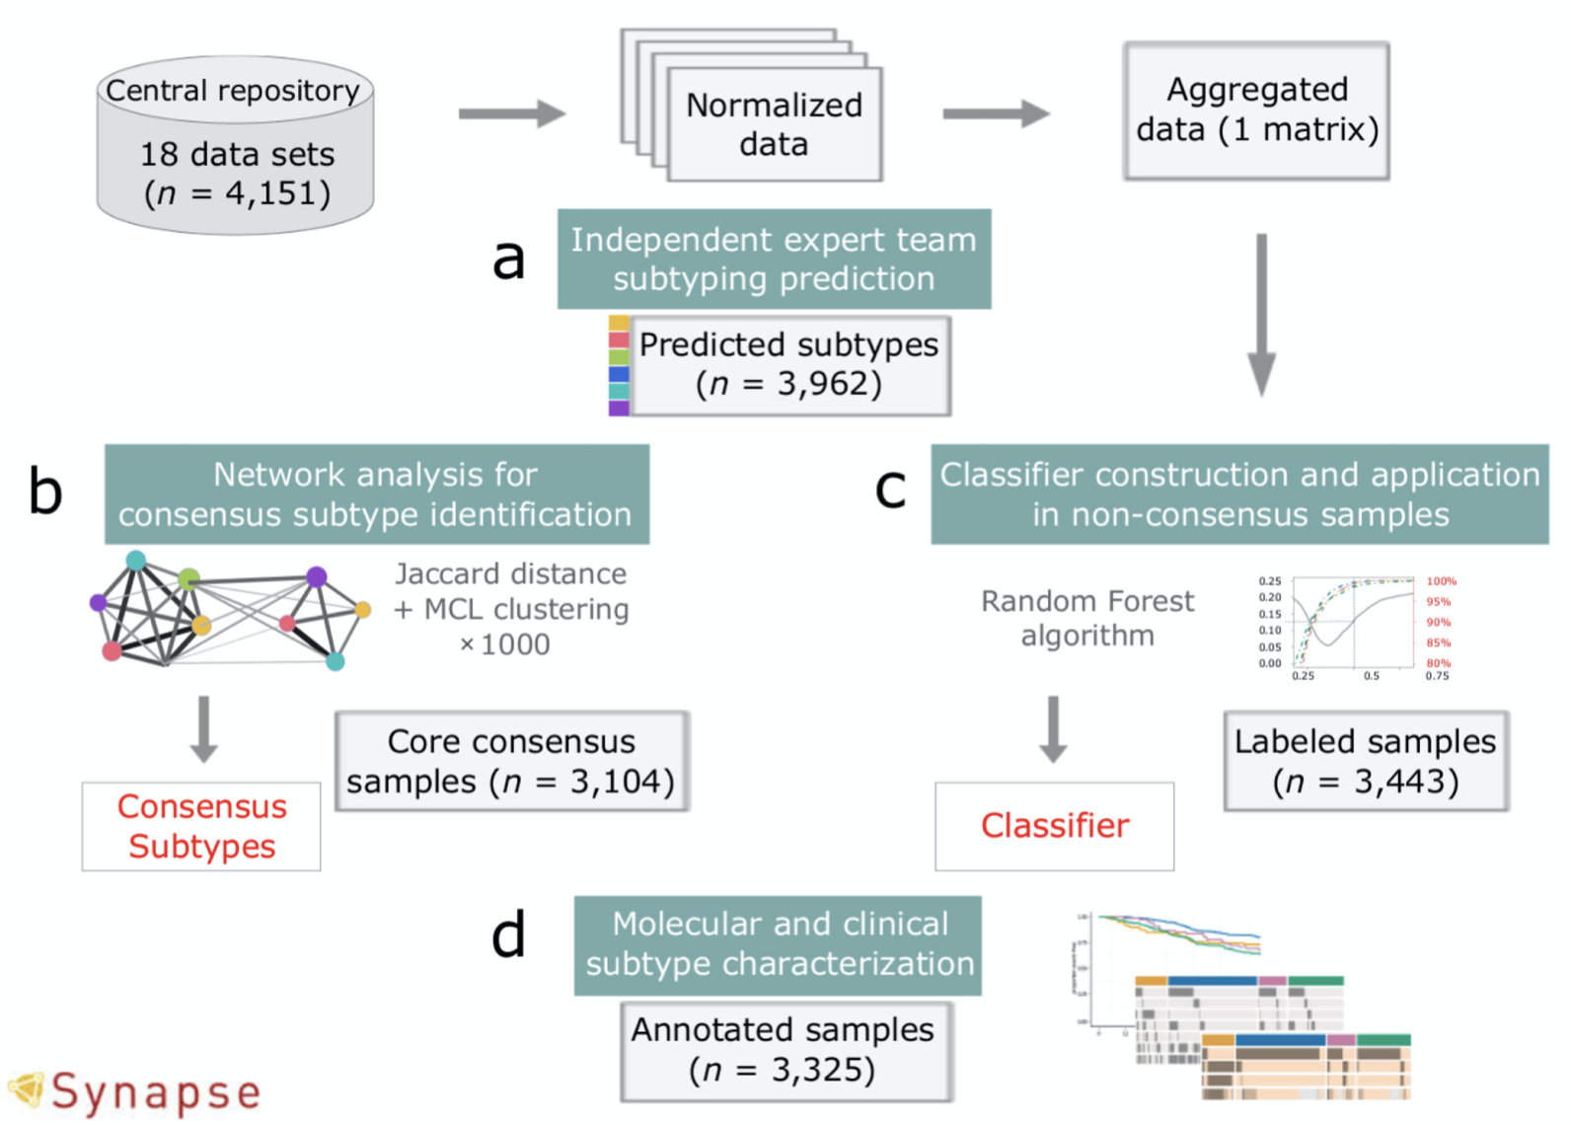
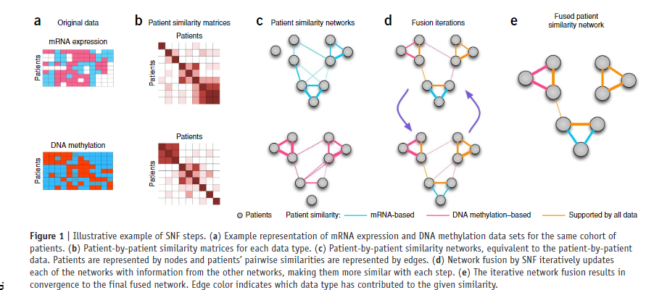
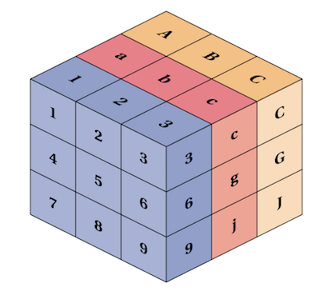
Integration of multi-sources
Consensus
Data fusion
Tensors
[Guinney et al 2015]
[Wang et al 2014]
multi-dimensional array
30

Slide 31


















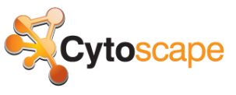

All-in-one computing platform
Programming
Dev Tools
VS Studio
user interface
Versioning
Database
analytics
data
Interactive Data Viz
infrastructure
d3.js
Cloud
Networks
Python
graph-tool
R
igraph

Slide 32
Applications

Slide 33








Molecular classification of breast cancer
Standard therapeutic
strategies
Heterogeneous disease
Genetic predisposition
lobular carcinoma
ductal carcinoma
- Surgery
- Chemo
- Radio
Pioneer in Computational Precision Medicine
1998: herceptin
1998: tamoxifen
2002 : 1st prognostic signature
(van ’t Veer et al | MammaPrint approved by FDA)
2003: 1st molecular classification
(Sorlie et al)

Slide 34
Molecular classification of breast cancer
500 patients
Consensus of 3 clustering methods
6 patient clusters
8 gene modules
[Guedj et al 2011]

Slide 35

Molecular classification of breast cancer
[Guedj et al 2011]

Slide 36

Molecular classification of breast cancer
Genomic alterations
Pathways associations
[Guedj et al 2011]

Slide 37
Molecular classification of breast cancer
Discovery set
500 samples
Validation set
3000 public samples
[Guedj et al 2011]

Slide 38
Molecular classification of breast cancer
bad prognostic
good prognostic
chimio
x
x
x
x
tamoxifen
x
x
x
x
herceptin
x
immuno
x
?

Slide 39



Molecular classification of Sjögren
341 RNA-seq on whole blood samples
Discovery set
Validation set
Multi-omics characterization
Canonical pathways & immunologic modules analysis
Methylomics
Flow cytometry / deconvolution
GWAS
Target identification,
drug repurposing,
drug combinations
Consensus of 3 clustering methods
4 patient clusters
3 gene modules
[Soret et al 2021; Desvaux et al 2022]

Slide 40




Molecular classification of Sjögren
UKPSSR (n = 144)
Matrix fusion
PRECISESADS (n = 341)
13 gene modules
ASSESS (n = 371)
GSE84844 (n = 30)
[Boudjeniba et al, ongoing]

Slide 41



Molecular classification of Sjögren
Sjögren
Control

Slide 42


Combination of repurposed drugs

Slide 43


Application to CMT1A
Direct to Phase 2
PMP22
Preclinics
No phase 1
[Attarian al 2014]
Phase 3
Disease network
[Chumakov et al 2014]
as of 2018

Slide 44



Application to AD
Phase 1
Event Related Potentials on Scopolamine healthy volunteers
Preclinics
Phase 2
Disease network
[Chumakov et al 2015]
[Nabirotchkin et al, in revision]
as of 2018

Slide 45

Patrimony

Slide 46

Patrimony

Slide 47





Patrimony
Immuno
Neuro
Onco
Covid-19
Prix Change 2020

Slide 48

Patrimony, application to covid-19
>> baricitinib
[Desvaux et al, 2021]

Slide 49
Patrimony, application to covid-19
dexamethasone
1000
known drug targets
58 disease
proteins
3000
drugs
anti-alarmins
[Desvaux et al, 2021]

Slide 50
Concluding remarks

Slide 51

Expected impact
- faster speed
- lower cost
- broader molecular diversity
- less animals in preclinical studies
- less patients in clinical studies
- improved chances of clinical success

Slide 52

Need for transversality & interface
bioinformatics
hardware
legal
statistics
cloud computing
high-throughput
biology
machine learning
network computing
pharmacology
clinical practice

Slide 53
What is a good model
« All models are wrong but some are useful. »
G. Box
simplicity
interpretability
robustness
reproducibility

Slide 54
Acknowledgement
ALL COLLABORATORS FROM
GENOPOLE
MERCK-SERONO
LIGUE CONTRE LE CANCER
PHARNEXT
SERVIER
NANOBIOTIX
INSA
ENSAI
STATOMIQUE

Slide 55
Thank you !

